Slide 1
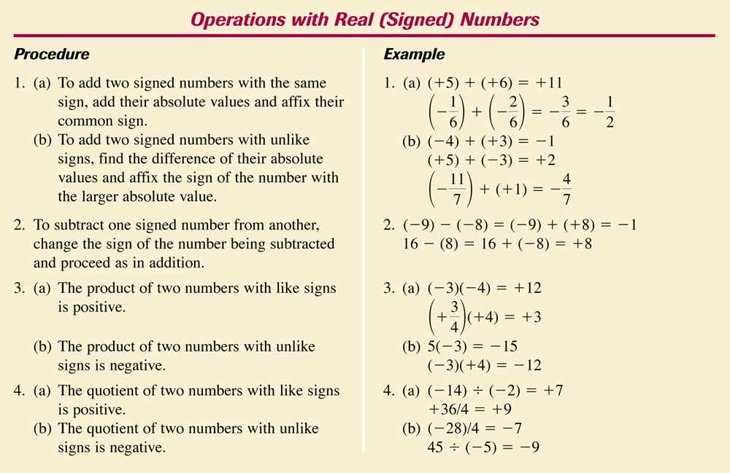
Operations with Real [Signed] Numbers
Copyright © by Houghton Mifflin Company, Inc. All rights reserved
0 - <number>

Slide 2
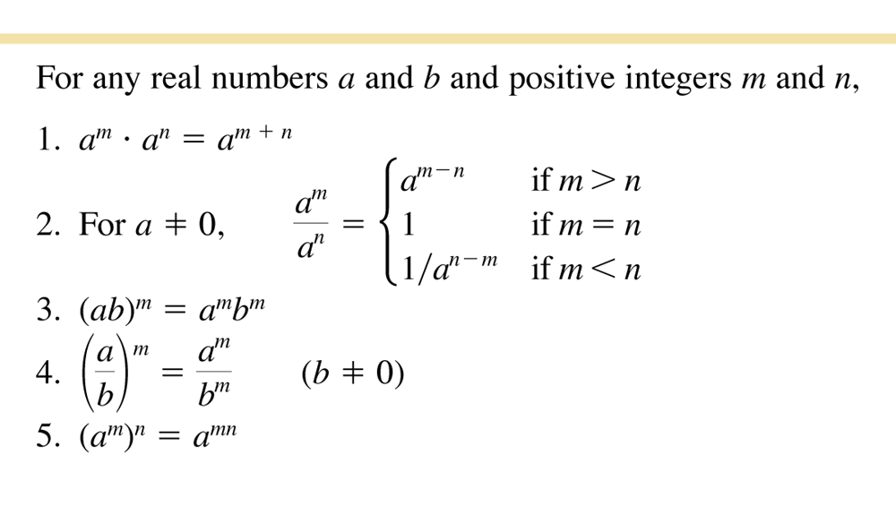
Positive Integer Exponents
Copyright © by Houghton Mifflin Company, Inc. All rights reserved
0 - <number>

Slide 3
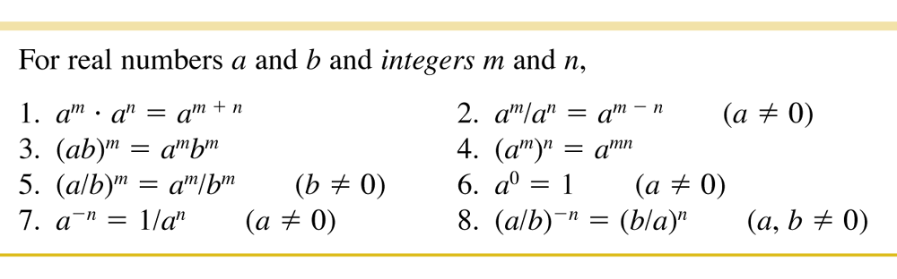
Rules of Exponents
Copyright © by Houghton Mifflin Company, Inc. All rights reserved
0 - <number>

Slide 4
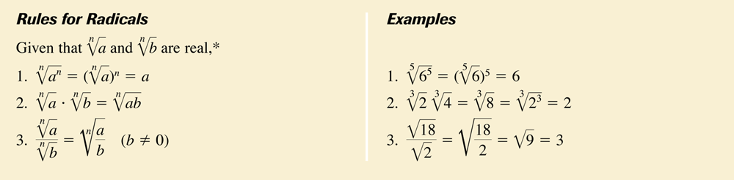
Rules for Radicals (and Examples)
Copyright © by Houghton Mifflin Company, Inc. All rights reserved
0 - <number>

Slide 5
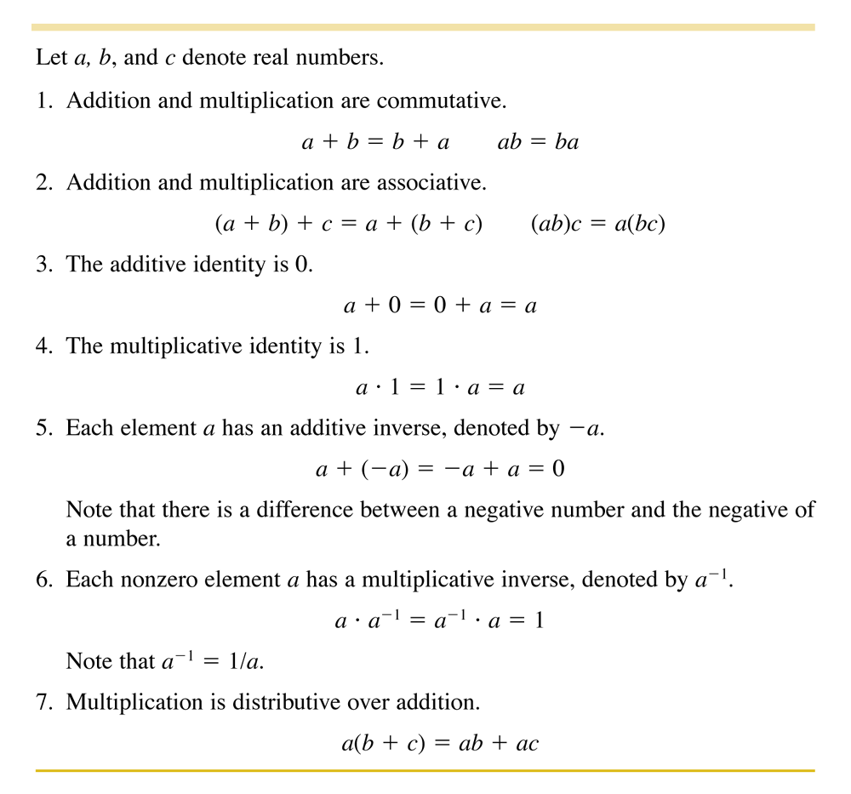
Properties of the Real Numbers
Copyright © by Houghton Mifflin Company, Inc. All rights reserved
0 - <number>

